Slide 1
I-40/CC On Ramp
Maxxwell Townsend, Mohammed Alshaiban,
Zach Johnson, Ramon Lopez
CENE 476
December 6th, 2019

Slide 2
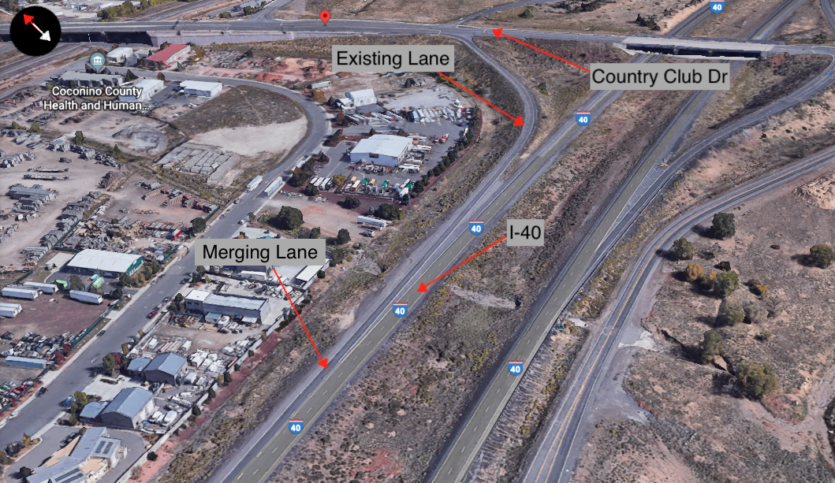

Project Purpose
One Southbound entrance onto I-40 westbound
Detention basin on north side
Adding an additional right turn lane to the on ramp to increase capacity
Expand existing on ramp from 1 to 2 lanes to reduce congestion
Figure 1-1: Zoomed in Project Location (Google Maps, NTS)

Slide 3

Stakeholders
Arizona Department of Transportation
Nate Reisner, P.E., Development Engineer
City of Flagstaff
Daily users of this facility
(Source: Wikipedia)

Slide 4
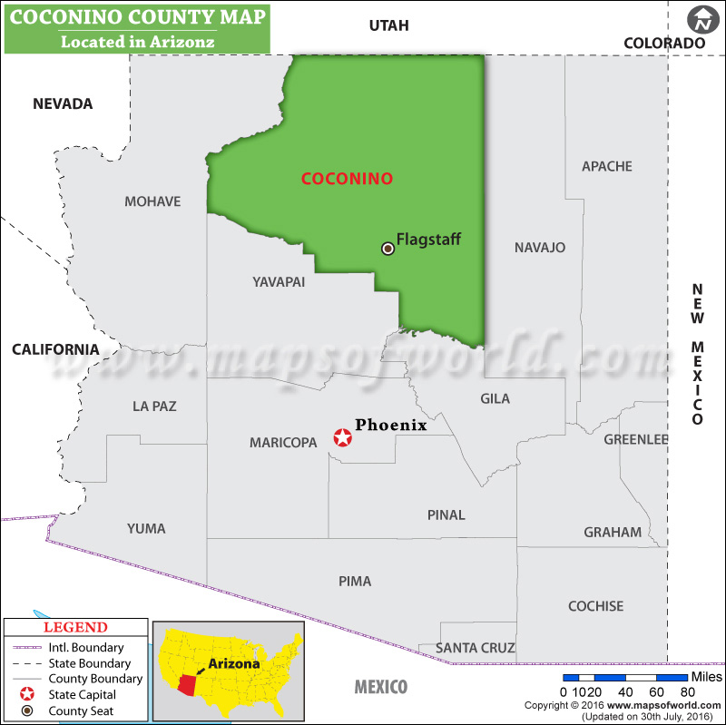
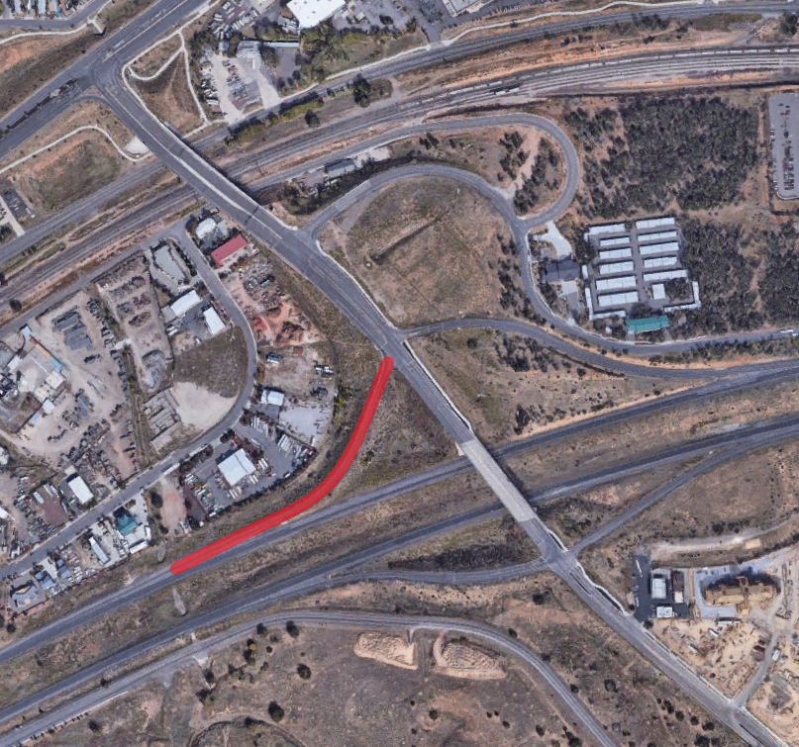
Project Location
The On-Ramp is located on N Country Club Drive and is adjacent to Interstate 40 in Flagstaff, AZ
N Country Club Dr.
I-40
Figure 1-2: State of Arizona with Project Location (www.mapsoftheworld.com, 1” = 80 miles)
Figure 1-3: Zoomed in Project Location (Google Maps, NTS)

Slide 5
Task 1: Analyze/Review Existing Studies
1.1 Site Visit
1.2 Process Survey Data from GIS
1.3 Analyze Existing Drainage Studies/Obtain As-Built Information
1.4 Existing Runoff Calculations
1.5 Obtain and Analyze Geotechnical data from ADOT
1.6 Input and Process Existing Geometry into Civil 3D
1.7 Create Existing Cross Sections
1.8 Create Roadway Alignments/Base Files

Slide 6
Task 2: Design
2.1 Design/Create Proposed Cross-Sections
2.2 Initial Design
2.2.1 Intersection Design
2.2.2 On-Ramp Design
2.3 Final Design Geometry/Cross-Sections
2.4 Final Drainage Design
2.5 Stormwater Pollution Prevention Control Plan
2.6 Construction Plan Set
2.7 Synchro Analysis and Traffic Analysis Recommendation

Slide 7
Task 3 & 4: Deliverables and Project Impacts
3.1 30% Submittal (Task 1)
3.2 60% Submittal (Task 2)
3.3 90% Submittal (Tasks 2-4)
3.4 Final Design Concept Report Submittal (Tasks 2-4)
3.5 Website
4.1 Economic Impacts
4.2 Environmental Impacts
4.3 Social Impacts

Slide 8
Task 5: Project Management
5.1 Grading Instructor Meetings
5.2 Client Meetings
5.3 Technical Advisor Meetings
5.4 Team Meetings
5.5 Schedule Management
5.6 Cost/Resource Management

Slide 9
Exclusions
Full Survey
Geotechnical Analysis
Collection of Traffic Data
Traffic Signal Planning
Environmental Permits / Mitigation Measures
Bridge Design
New Drainage Infrastructure Design

Slide 10
Critical Path shown in Red

Slide 11
Staffing
Tasks | PM | PE | EIT | TECH | Total
2.1 Task 1: Existing Studies | 6 | 18 | 40 | 52 | 116
2.2 Task 2: Design | 17 | 38 | 98 | 74 | 227
2.3 Task 3: Deliverables | 9 | 16 | 42 | 30 | 97
2.4 Task 4: Impacts | 3 | 3 | 6 | 0 | 12
2.5 Task 5 Project Management | 42 | 42 | 38 | 38 | 160
Total | 77 | 117 | 224 | 194 | 612
612 Total estimated hours for this project
PE will lead Design Work
PM will review work and ensure QA/QC

Slide 12
Cost Estimate
1.0 Team Members | Billing Rate | Hours | Cost
PM | $195.00 | 77 | $15,015.00
PE | $155.00 | 117 | $18,135.00
EIT | $110.00 | 224 | $24,640.00
TECH | $75.00 | 194 | $14,550.00
Total |  |  | $72,340.00
2.0 Travel
8 Meetings @ 4 mi/meeting |  | $0.58 mi/meeting | 19
5 Meetings @ 2.5 mi/meeting |  | $0.58 mi/meeting | 10
Total |  |  | 29
Total Cost of Engineering Services |  |  | $72,369.00
Total Estimated Cost of Engineering Services is $72,369
Travel Cost is Minimal, but was Included for Accuracy

Slide 13
References
[1] “AASHTO-Roadside-Design-Guidelines,” American Association of State Highway and Transportation Officials, vol. 4th, 2011
[2] “ADOT Roadway Design Guidelines,” Arizona Department of Transportation, May 2012
[3] “Coconino County Map” (2016). [Image] Available at: www.mapsoftheworld.com [Accessed 4 Dec. 2019].

Slide 14
Questions?

